Slide 1





P4runpro: Enabling Runtime Programmability for RMT Programmable Switches
Yifan Yang¹, Lin He^{1,2}, Jiasheng Zhou¹, Xiaoyi Shi¹, Jiamin Cao³, Ying Liu^{1,2}
Notes:
(Thanks for the introduction).
Hello everyone.
I am Yifan Yang from Tsinghua University.
I will introduce our paper “P4runpro: Enabling Runtime Programmability for RMT Programmable Switches”.
The other authors are from Tsinghua University, Zhongguancun Laboratory, and Alibaba Cloud.

Slide 2

Contents
1. Background
2. State of the art
3. Key idea
4. Design
5. Implementation
6. Evaluation
7. Case studies
8. Conclusion
Yifan Yang, Tsinghua University, SIGCOMM 2024
Notes:
Here are the contents of the presentation.

Slide 3





P4 in RMT: a Single Data Plane
RMT programmable switches only support a single-context data plane
Orthogonal programs need to be separated
prog1.p4
prog1_and_prog2.p4
Compile
& install
Traffic cannot be interrupted
prog1
prog1&2
Programmer
Fixed-function switch
New
fixed-function switch
RMT
RMT
Operator
Interrupted switch
To deploy a new program prog2.p4, the operator needs:
Couple the new function with the original ones: complex and difficult to manage
Interrupt all traffic and reprovision the switch: unavailable time for services
Yifan Yang, Tsinghua University, SIGCOMM 2024
Notes:
So first is the background.
For current RMT switches, there is a single data plane context defined by P4.
After we compile and install the P4 program into the switch, the switch will become a fixed-function switch
If we want to add a new function or program to it, we must suspend the traffic and reprovision the switch.
This is unfriendly to us as programmers and operators.
As programmers, we don't want unrelated programs to be coupled into one program.
As operators, we don't want the traffic to be interrupted.

Slide 4






OS on CPU: an Abstraction Layer
RMT programmable switches only support a single-context data plane
CPU programmer: we have the operating system!
CPU programmer
OS
Hardware
Translate code
Maintain processes
Allocate resources
All I have to do is coding
Do as the OS tells
What has an OS done for the programmers?
Runtime programming: programmers can dependently run and terminate programs as they wish
Interfaces: programmers use the OS interfaces to program
Resource isolation: automatically allocates CPU cycles and memory for programs
Yifan Yang, Tsinghua University, SIGCOMM 2024
Notes:
However, the programmers on the CPU architecture do not face the problem.
Because they have the operating systems.
What they only have to do is to craft their programs using high-level languages like C and CPP.
And the hardware is not visible to the programmer.
The OSes can provide compilers to translate our programs to binary code, maintain processes, and automatically manage the CPU cycles and memory for our programs.

Slide 5

OS layer on RMT ASIC?
Can we build an OS-like software between the programmer and the switch hardware?
RMT
RMT programmer
OS-like layer
Switch
Provide programming interfaces and
manage the hardware
All I have to do is coding
One-shot provision
Runtime updated
With this layer, we can:
Update the switch programs without interrupting traffic and unrelated programs
Dynamically allocate the memory resources of the Hardware for deployed programs
Yifan Yang, Tsinghua University, SIGCOMM 2024
Notes:
So can we build an OS-like layer between the programmer and the RMT switches?
The OS-like layer can provide abstract programming interfaces for the programmers and manage the hardware.
The switch only needs to be provisioned once with the OS-like layer.
The programmer then only need to code.

Slide 6

State of the Art
Solution #1: Seek for new hardware architecture
Menshen (NSDI ’22): Architectural extension for RMT
IPSA (NSDI ’22): New designed architecture
FlexCore (NSDI ’22 and NSDI ’23): Utilize the dRMT architecture
Cannot be implemented on the popular RMT architecture
Yifan Yang, Tsinghua University, SIGCOMM 2024
Notes:
There are lots of related works to achieve runtime programmability.
The first type seeks for new hardware architecture.
They utilize FPGA or dRMT switches to enable runtime programmability.
However, their solutions cannot be ported to popular RMT switches.

Slide 7
State of the Art
Solution #1: Seek for new hardware architecture
Menshen (NSDI ’22): Architectural extension for RMT
IPSA (NSDI ’22): New designed architecture
FlexCore (NSDI ’22 and NSDI ’23): Utilize the dRMT architecture
Solution #2: Virtualization
Hyper4 (CoNEXT ’16) and HyperV (ICCCN ’17): Runtime program reconfiguration
Incur high overhead that they cannot be deployed on hardware targets
Yifan Yang, Tsinghua University, SIGCOMM 2024
Notes:
The second type virtualizes the data plane tables and supports runtime program reconfiguration.
However, their solutions are extremely resource-consuming and cannot be deployed on hardware targets.

Slide 8
State of the Art
Solution #1: Seek for new hardware architecture
Menshen (NSDI ’22): Architectural extension for RMT
IPSA (NSDI ’22): New designed architecture
FlexCore (NSDI ’22 and NSDI ’23): Utilize the dRMT architecture
Solution #2: Virtualization
Hyper4 (CoNEXT ’16) and HyperV (ICCCN ’17): Runtime program reconfiguration
Solution #3: Dynamic resources
NetVRM (NSDI ’22): Dynamic memory
Newton (CoNEXT ’20) and FlyMon (SIGCOMM ’22): Runtime reconfiguration of tasks with similar logic
Only support a set of preconfigured programs
Yifan Yang, Tsinghua University, SIGCOMM 2024
Notes:
The third type is dynamic resources.
NetVRM enables dynamic memory.
Newton and FlyMon enable runtime reconfiguration of similar programs.
They only support a set of preconfigured programs, lacking generality.

Slide 9
State of the Art
Solution #1: Seek for new hardware architecture
Menshen (NSDI ’22): Architectural extension for RMT
IPSA (NSDI ’22): New designed architecture
FlexCore (NSDI ’22 and NSDI ’23): Utilize the dRMT architecture
Solution #2: Virtualization
Hyper4 (CoNEXT ’16) and HyperV (ICCCN ’17): Runtime program reconfiguration
Solution #3: Dynamic resources
NetVRM (NSDI ’22): Dynamic memory
Newton (CoNEXT ’20) and FlyMon (SIGCOMM ’22): Runtime reconfiguration of tasks with similar logic
ActiveRMT (SIGCOMM ’23): Runtime program execution in an active network
SwithVM (NSDI ’24): Concurrent work with a similar idea to P4runpro
Introduce throughput and end host overhead by storing programs in the header
Yifan Yang, Tsinghua University, SIGCOMM 2024
Notes:
ActiveRMT and SwitchVM enable runtime programmability on the RMT switches.
However, ActiveRMT can only be deployed in an active network where the program is attached to the header.
SwitchVM also has similar problems and wastes nearly half of the memory in the pipeline.

Slide 10

Key Idea
How does P4runpro enable general runtime programmability without any assumption for the coming packet?
Key idea:
Decouple the switch programs into pre-defined atomic operations at compile-time
Dynamically allocate resources and combine the atomic operations into switch programs at runtime
Yifan Yang, Tsinghua University, SIGCOMM 2024
Notes:
So, to bridge the gap, P4runpro enables general runtime programmability for RMT hardware without any assumption for the coming packet
Our key idea is that we can decouple the switch programs into pre-defined atomic operations at compile-time.
And then, after we provision the switch, we can dynamically allocate resources and combine the atomic operations into switch programs at runtime.

Slide 11
P4runpro Architecture
P4runpro Primitive Set
P4runpro Control plane
Program compilation
Resource management
Program downloading
Primitive
Pseudo Primitive
Craft programs via P4runpro primitives
Runtime Entries
Runtime Programming Blocks (RPBs)
Pkts
Initialization
Recirculation
PHV
ALU
SALU
Hash Unit
Data Plane
PHV
Memory
RMT
p4runpro.p4
Yifan Yang, Tsinghua University, SIGCOMM 2024
Notes:
Our architecture has three parts.
(click) The first one is the data plane. We build our data plane pipeline with a one-shot compiled P4 program.
The pipeline has an initialization block, several runtime programming blocks, RPBs, and a recirculation block.
The RPB is the general program execution unit that can perform atomic operations.
(click) Second, we provide a set of programming interfaces we call P4runpro primitives.
(click) In addition to the interfaces and hardware pipeline, we also build our control plane.
This control plane can compile the P4runpro primitives, manage the hardware resources, and download the program to the hardware.
(clickx2) Through this, the programmer only needs to craft their P4runpro programs and input them into the control plane compiler.
They do not need to care too much about how the hardware works.
And the control plane automatically deploy the program to the data plane.

Slide 12
Packet Processing
Challenge #1: How to build the runtime ‘OS’ (one-shot compiled p4-defined data plane) on the resource-limited RMT switches
Solution: virtualize the stateless PHV, stateful memory, and computing units by atomic operations
PHV:
Header and metadata are extracted into or modified by PHV ‘registers’
Memory
A mask-based address translation mechanism virtualizes the physical memory
Computing units
Hash units and PHV ALUs: Interacting with registers
SALUs: Operating virtual memory
Runtime Programming Blocks (RPBs)
PHV
ALU
SALU
Hash Unit
Registers
Virtual Memory
Headers & Intrinsic metadata
Yifan Yang, Tsinghua University, SIGCOMM 2024
Notes:
So here comes the first challenge: how do we build the one-shot compiled p4-defined data plane on the resource-limited RMT switches?
(click) Our solution is to virtualize the resources, including the stateless PHV, stateful memory, and computing units.
For the PHV, we defined several ‘registers’ in the PHV.
Their values are extracted from the header or metadata and can be used to modify the header or metadata.
For memory, we use a mask-based address translation mechanism to virtualize the physical memory, allowing the memory to be dynamically allocated at runtime.
For the computing units, we pre-define a set of atomic operations; they can operate the registers and virtual memory, completing the packet processing logic.

Slide 13
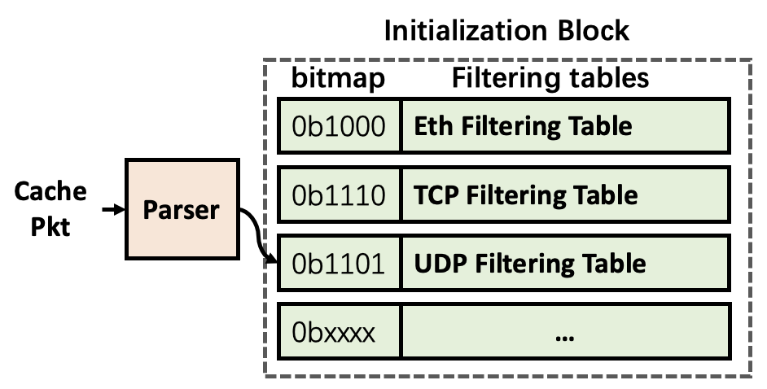
Packet Processing
Step1: Identify the packet
Pkts
Use a bitmap to track the parsing path
Different bitmap values triggers different filtering tables
The filtering table identifies the packet and assigns its program by setting the flag program_id
Yifan Yang, Tsinghua University, SIGCOMM 2024
Notes:
For the specific process of program execution, when a packet comes, it goes into the initialization block first.
In the block, we track its parsing path using a bitmap.
Then different bitmap values will trigger different filtering tables.
The filtering table will distinguish the packet type by matching the header fields and assign its program by setting a flag called program ID.

Slide 14
Packet Processing
Step2: Execute the primitive
Runtime Programming Blocks (RPBs)
PHV
ALU
SALU
Hash Unit
Registers
Virtual Memory
RPBs first check the program control flow flags:
program_id: identify what program is for this packet
branch_id: identify which conditional branch the packet is in
recirculation_id: identify how many cycles have the packet been recirculated
Yifan Yang, Tsinghua University, SIGCOMM 2024
Notes:
Then the packet goes into the RPBs sequentially.
We have three program control flow flags, called program ID, branch ID, and recirculation ID.
The program ID is used for RPB to distinguish the current program for the packet.
The branch ID is to distinguish the current condition branch.
And the recirculation ID is to distinguish the current recirculation iteration.
Before real execution, the RPB will first check the three flags.

Slide 15
Packet Processing
Step2: Execute the primitive
RPBs
RPB (executing BRANCH)
Match
Action
Match
Action
program_id
branch_id
recirculation_id
ADD,
MEM_OP,
HASH,
···
program_id
branch_id
recirculation_id
register[]
Set_branch_id
RPBs sequentially execute primitives in a dependency chain
Primitive BRANCH makes the program go into a different conditional branch by changing the branch_id
Yifan Yang, Tsinghua University, SIGCOMM 2024
Notes:
If the RPB matches the three flags, the RPB will execute one primitive.
The primitives in a dependency chain will be sequentially executed by RPBs.
For a special primitive, BRANCH, the RPB will additionally match the values of the registers and make the program go into a different conditional branch by changing the branch ID flag.

Slide 16
Packet Processing
Step2: Execute the primitive
RPB (executing BRANCH)
RPB (after branch)
Match
Action
Match
Action
program_id
branch_id
recirculation_id
register[]
Set_branch_id
branch_id == 0
···
Primitive in branch 0
branch_id == 1
···
Primitive in branch 1
RPBs sequentially execute primitives in a dependency chain
Primitive BRANCH makes the program go into different conditional branches by changing the branch_id
RPBs parallelly execute primitives in different branches
Yifan Yang, Tsinghua University, SIGCOMM 2024
Notes:
After the branch, the primitives in different branches will be executed in parallel in the same RPB according to the flag branch ID.

Slide 17
Packet Processing
Step3: Recirculate
Recirculation Block
EOF? Recirculate(): NoAction()
Pkts
RPBs
Problem: RMT’s pipeline manner limits the number of RPB executions
Solution
Recirculate the packet if the program is not end
The flag recirculation_id tracks the process
Yifan Yang, Tsinghua University, SIGCOMM 2024
Recirculation Block
Notes:
Then after all the RPBs are executed.
The packet arrives at the end of the pipeline.
Here comes a problem: we have limited RPB executions.
So we utilize the recirculation function of the switch to enable the programs with longer dependency chains.
If the program does not end after the packet arrives at the last RPB, we recirculate it to the first RPB to continue the program execution.
We use the flag recirculation ID to track the process.

Slide 18
P4runpro Primitive Set
Challenge #2: How to achieve as many as possible atomic operations (primitives) under the extremely limited in-switch VLIW instruction?
Solution:
Compress the primitive set
Design the pseudo primitive
Yifan Yang, Tsinghua University, SIGCOMM 2024
Notes:
Now we have prepared the data plane, the next we need is to provide the programming interfaces for the programmers.
However, the limited VLIW instruction resource means that we cannot pre-define too many atomic operations in the switch.
(click) Our solution is to compress the primitive set and design the pseudo primitive.

Slide 19
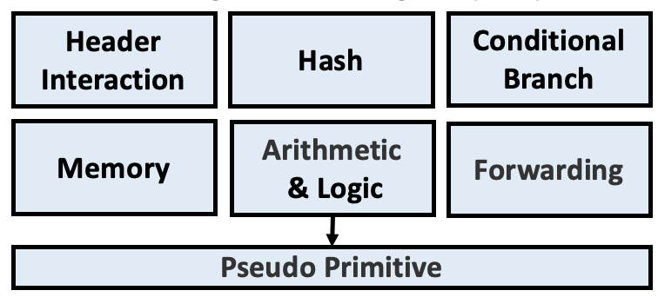
P4runpro Primitive Set
Solution #1: Compress the primitive set
Observation: many switch programs can be divided into a combination of these six types of operations
Yifan Yang, Tsinghua University, SIGCOMM 2024
Notes:
First, we compress the primitive set based on the observation that many switch programs can be divided into a combination of six types of operation, including header interaction, hash, conditional branch, memory, arithmetic & logic, and forwarding.

Slide 20
P4runpro Primitive Set
Solution #1: Compress the primitive set
Observation: many switch programs can be divided into a combination of these six types of operation
Solution #2: Design the pseudo primitive
Similar to pseudo-instruction, a pseudo primitive is
equivalent to a primitive when programming but
replaced by one or more primitives for hardware execution
Example:
Support ADDI by executing LOADI & ADD in the hardware
Yifan Yang, Tsinghua University, SIGCOMM 2024
Notes:
Then we design the pseudo primitive to support more general programming.
The pseudo primitive is similar to the pseudo-instruction in the assembly language.
A pseudo primitive is equivalent to a primitive when programming but replaced by one or more primitives for hardware execution.
For example, we can provide primitive ADDI for programmers and implement it by actually executing LOADI and ADD in the hardware.

Slide 21
P4runpro Compiler
Challenge #3: How to transfer the program into data plane configuration?
Solution: Build a control plane with a compiler that
Automatically translate the programs into runtime entries
Efficiently allocate resources for the programs
Consistently update the data plane
Yifan Yang, Tsinghua University, SIGCOMM 2024
Notes:
OK, now we have both the programming interfaces and the virtualized hardware.
We still face the challenge of how to link the program to the hardware.
(click) So we build the P4runpro control plane with the main component of the P4runpro compiler.
The compiler can automatically parse the programs, allocate resources for the programs, and consistently update the data plane.

Slide 22
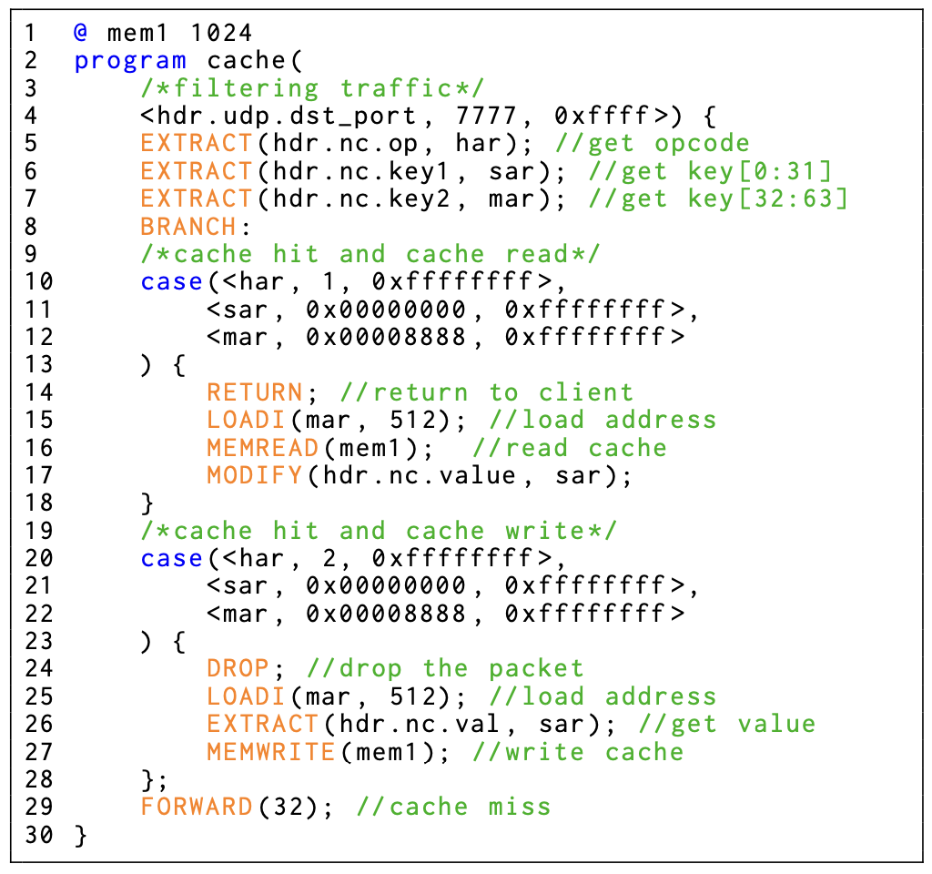
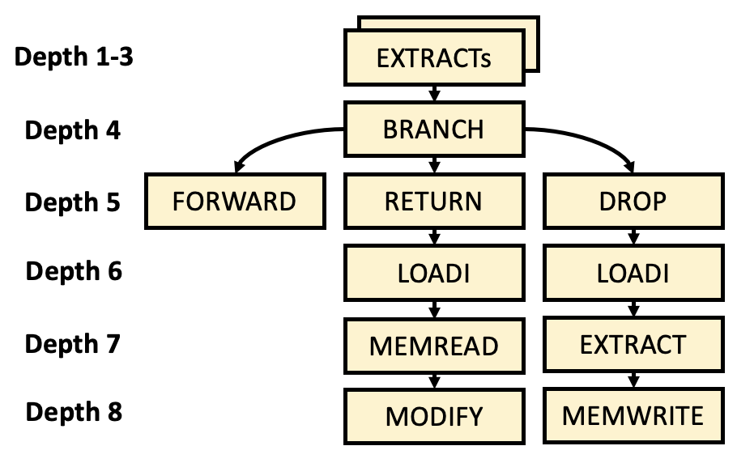
P4runpro Compiler Workflow
Step 1: Syntax and Semantics Check
Parse the program string, check the syntax and argument type
Generate the Abstract Syntax Tree (AST)
cache.p4runpro
(detailed in the paper)
Yifan Yang, Tsinghua University, SIGCOMM 2024
Notes:
When we invoke the compiler to compile a program, for example, a cache program detailed in the paper.
The compiler first performs a syntax and semantics check and generates the AST.
Each primitive is a node and each dependency chain is a subtree.

Slide 23
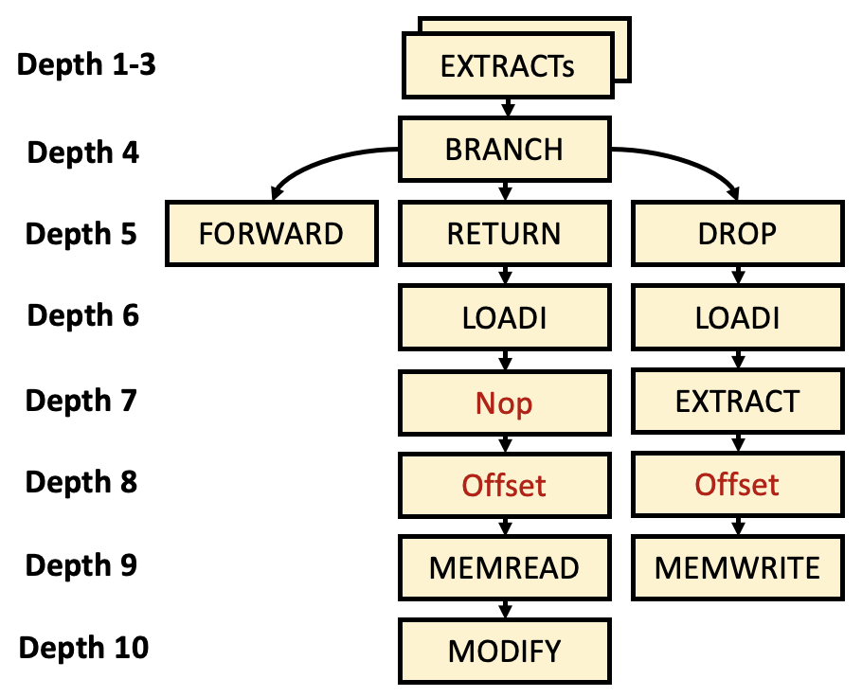
P4runpro Compiler Workflow
Step 1: Syntax and Semantics Check
Parse the program string, check the syntax and argument type
Generate the Abstract Syntax Tree (AST)
Step 2: Primitive Translation
Address translation
Pseudo primitive translation
See our paper for detail ☺
Yifan Yang, Tsinghua University, SIGCOMM 2024
Notes:
Then the compiler will add the address translation and pseudo primitive translation steps.
For time reasons, we do not go into detail about this.

Slide 24
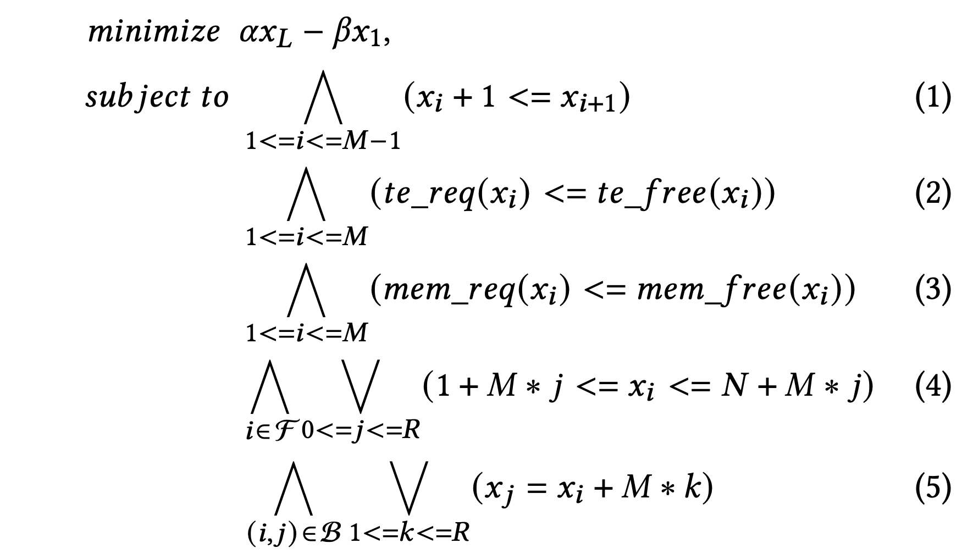
P4runpro Compiler Workflow
Step 1: Syntax and Semantics Check
Parse the program string, check the syntax and argument type
Generate the Abstract Syntax Tree (AST)
Step 2: Primitive Translation
Add address translation steps (detailed in the paper)
Translate the pseudo primitives
Step 3: Program Allocation
Formalized the hardware resource constraints into an SMT problem
A first-come-first-serve and best-effort scheme
Yifan Yang, Tsinghua University, SIGCOMM 2024
Notes:
Then the compiler performs an allocation scheme, which is formalized into an SMT problem.
It is a first-come-first-serve and best-effort scheme.
And it will determine which RPB to execute which primitives.
During this process, the memory and table entry resources of data plane is automatically allocated.

Slide 25
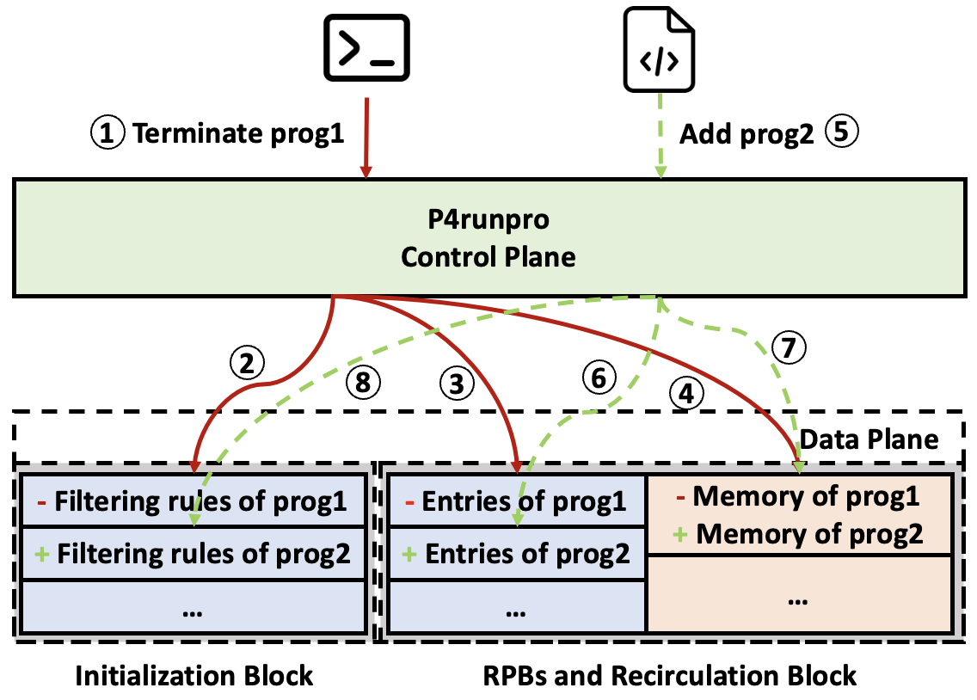
P4runpro Compiler Workflow
Step 1: Syntax and Semantics Check
Parse the program string, check the syntax and argument type
Generate the Abstract Syntax Tree (AST)
Step 2: Primitive Translation
Add address translation steps (detailed in the paper)
Translate the pseudo primitives
Step 3: Program Allocation
Formalized into an SMT problem with 5 constraints
Step 4: Consistent update
Problem: Updating the data plane with the traffic running may result in undefined/unwanted behaviors
Solution: Utilize the program control flow flag program_id to enable a full program to be deployed/removed after an atomic rule update
Yifan Yang, Tsinghua University, SIGCOMM 2024
Notes:
The last step is to update the data plane.
We face the problem that if we update the data plane with the traffic running, there may be some undefined/unwanted behaviors.
Fortunately, we can utilize the control flow flag program ID to ensure the atomicity and consistency of the data plane update.
If we want to terminate a program, we first delete the single entry of the filtering rule.
Then all the subsequent RPBs will stop at the same time since there will be no more packets assigned with the corresponding program ID.
Similarly, if we want to add a new program, we add the filtering rule after all other rules are ready.

Slide 26

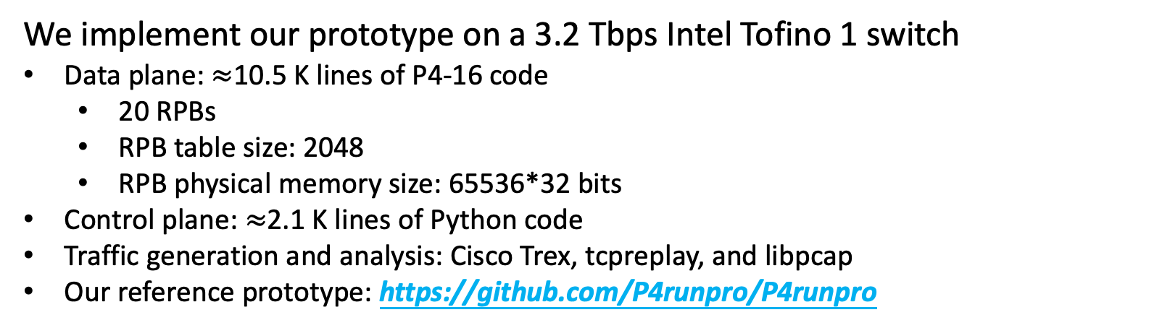
Implementation
We implement our prototype on a 3.2 Tbps Intel Tofino 1 switch
Data plane: $≈$10.5 K lines of P4-16 code
20 RPBs
RPB table size: 2048
RPB physical memory size: 65536*32 bits
Control plane: $≈$2.1 K lines of Python code
Traffic generation and analysis: Cisco Trex, tcpreplay, and libpcap
Our reference prototype: https://github.com/P4runpro/P4runpro
Yifan Yang, Tsinghua University, SIGCOMM 2024
Notes:
That’s all the design.
We implemented our prototype on an Intel Tofino 1 switch.
We implemented 20 RPBs, with a table size of 2K and memory bucket number of 64K.

Slide 27
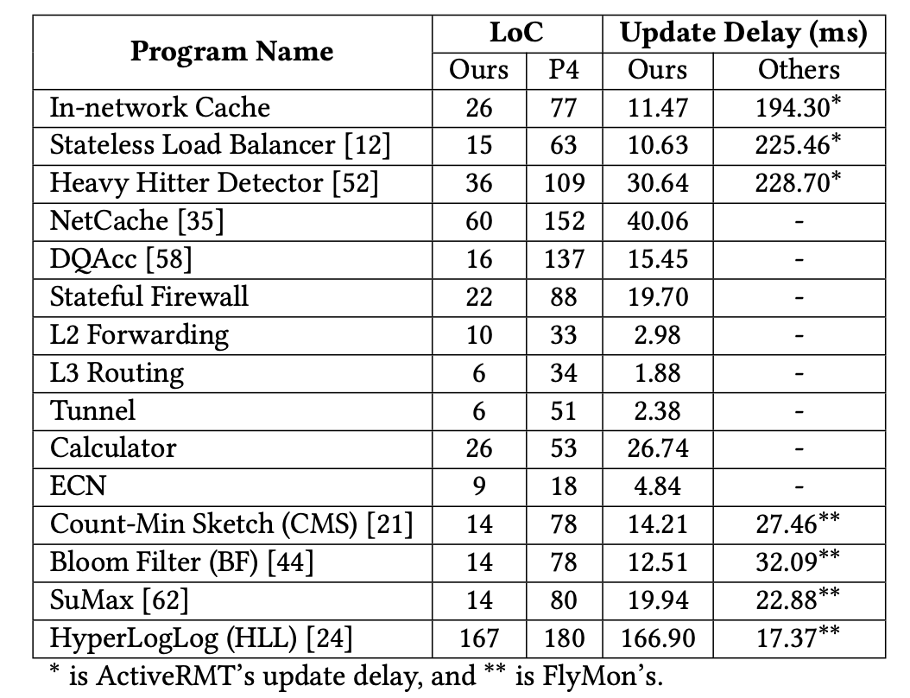
Evaluation
Generality and Expressiveness
We implemented 15 runtime popular and various switch programs
Compare the simplicity of P4runpro programs and corresponding P4 programs
Yifan Yang, Tsinghua University, SIGCOMM 2024
Notes:
Then, we use the prototype for evaluation.
We evaluate P4runpro first in generality and expressiveness.
We use P4runpro primitives to craft 15 runtime programs.
These programs can be deployed and revoked at runtime without restarting the switch and pausing the traffic.
We also compare their simplicity to the P4 programs.
The result shows that P4runpro can express P4 logic using a smaller number of P4runrpro primitives.

Slide 28
Evaluation
Performance: Update Delay
Compared to ActiveRMT (SIGCOMM ’23) and FlyMon (SIGCOMM ’22)
14/15 programs are in 41 ms
Update the data plane faster
Yifan Yang, Tsinghua University, SIGCOMM 2024
Notes:
We then compare the data plane update delay to ActiveRMT and FlyMon.
Most of the programs can be updated in 41 milliseconds, which is faster than ActiveRMT and FlyMon.

Slide 29
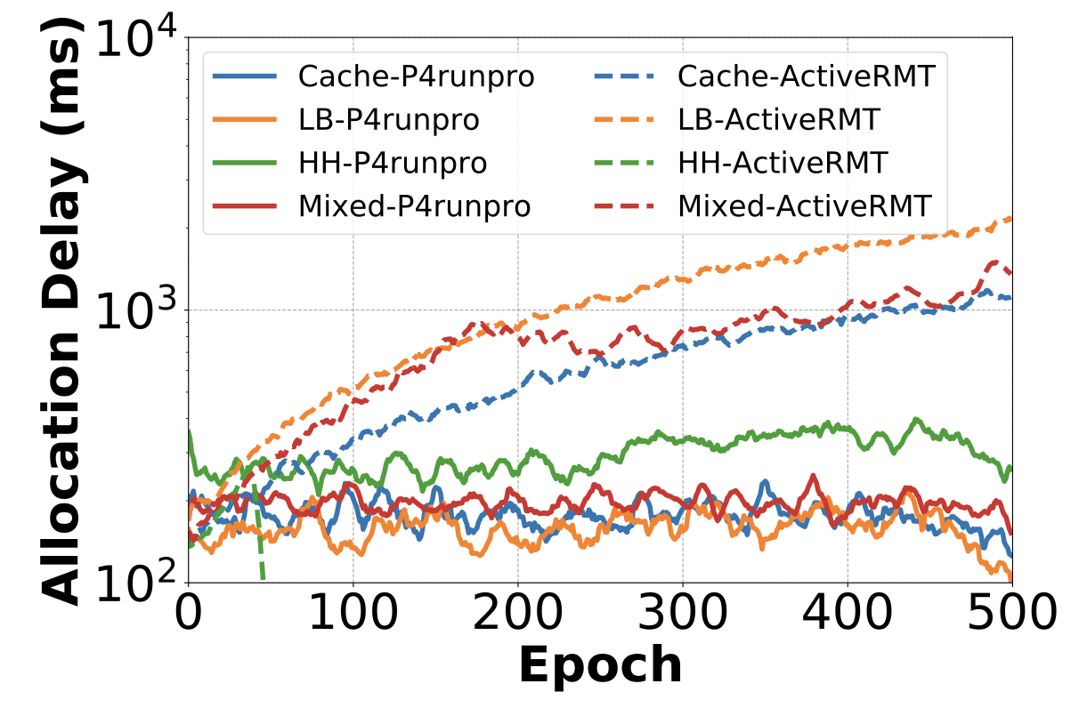
Evaluation
Performance: Allocation Delay
Compared to ActiveRMT (SIGCOMM ’23)
500 rounds (X-axis) of program deployment
Workload programs:
In-network cache (Cache)
Stateless Load balancer (LB)
Heavy Hitter Detector (HH)
Mixed of the three programs above
P4runpro compiler can compute the allocation result in 400 ms
P4runpro’s allocation scheme is not sensitive to the distribution of allocated programs
Yifan Yang, Tsinghua University, SIGCOMM 2024
Notes:
Then we compare our allocation delay to ActiveRMT.
We continued to deploy programs and used four workloads, the in-network cache, stateless load balancer, heavy hitter detector, and a mix of them.
We find that our allocation scheme can find the solution in four hundred milliseconds regardless of the resource distribution of the data plane.

Slide 30
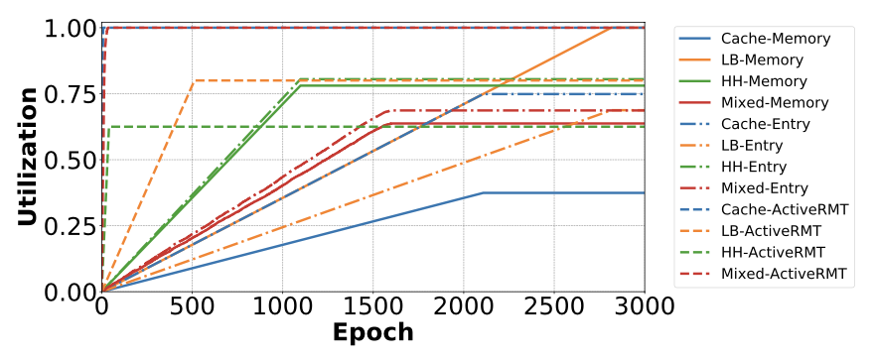
Evaluation
Performance: Resource Utilization
Memory utilization:
Cache: 38%
LB: 100%
HH: 78%
Mixed: 65%
Table entry utilization:
Cache: 75%
LB: 70%
HH: 80%
Mixed: 70%
Continuously deploy the program until the compiler fails
Average 65%～80% utilization
Yifan Yang, Tsinghua University, SIGCOMM 2024
Notes:
Then we evaluate our memory and table entry utilization of the four workloads.
We find that P4runpro can achieve average 65% to 80% resource utilization.

Slide 31
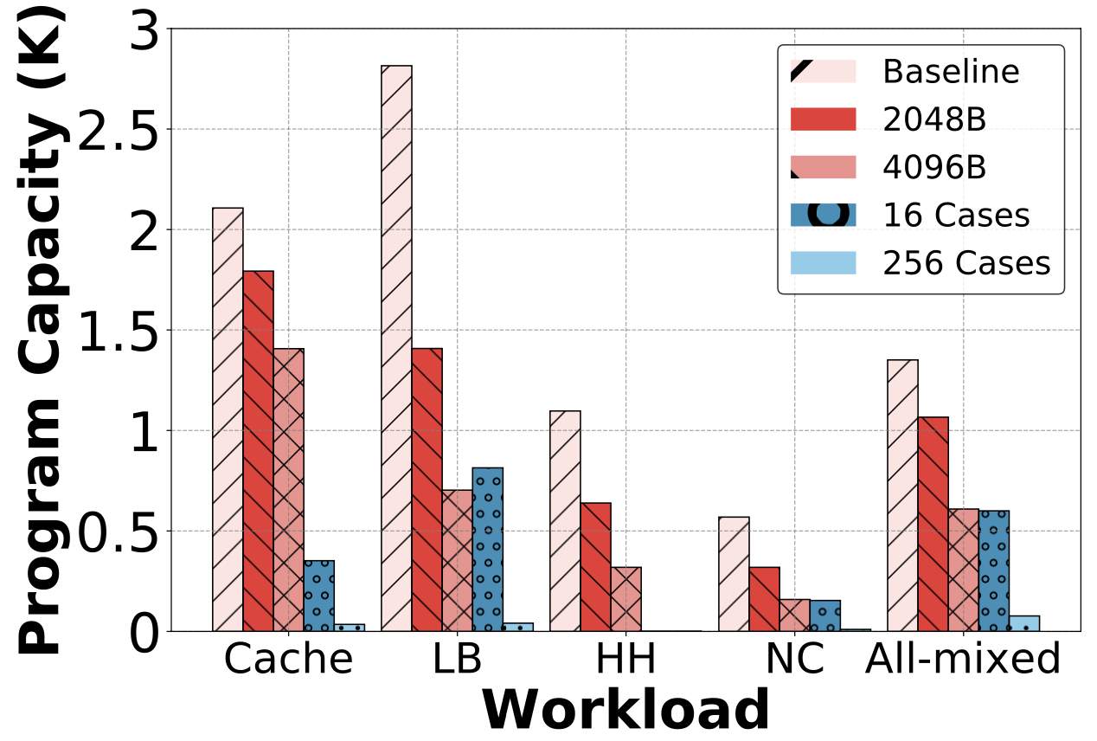
Evaluation
Performance: Program Capacity
Requested memory size ranging from 1024B to 4096B
Number of elastic case blocks ranging from 1 to 256 (HH does not have)
Add 2 new workloads NetCache (NC) and All-mixed that contains all the implemented 15 programs
Concurrently run a maximum of 2.8K isolated LB programs
Concurrently run 77 to 1.3K isolated programs under the All-mixed workload
Yifan Yang, Tsinghua University, SIGCOMM 2024
Notes:
We then add two new workloads, the program NetCache and all-mixed of the mix of all the 15 programs.
We evaluate the program capacity of how many programs the data plane can support concurrently.
We find that P4runpro can enable a maximum of 2.8K programs for the workload LB and 77 to 1.3K concurrent programs under the workload all-mixed.

Slide 32
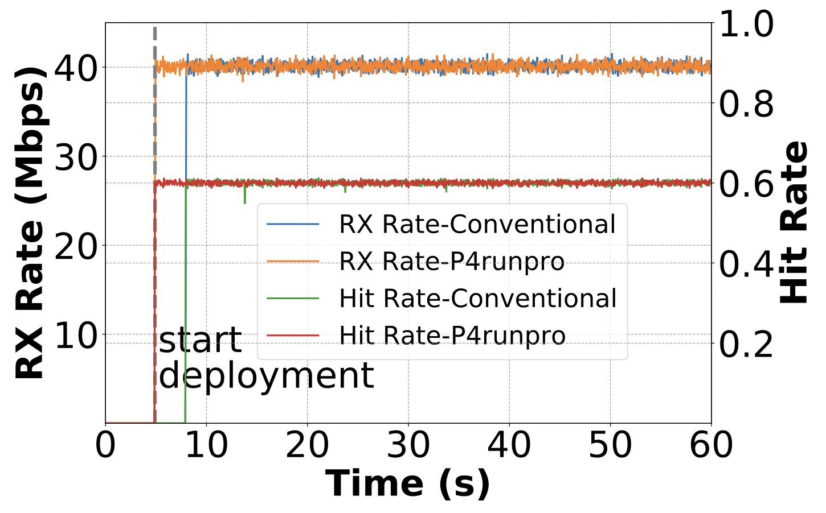
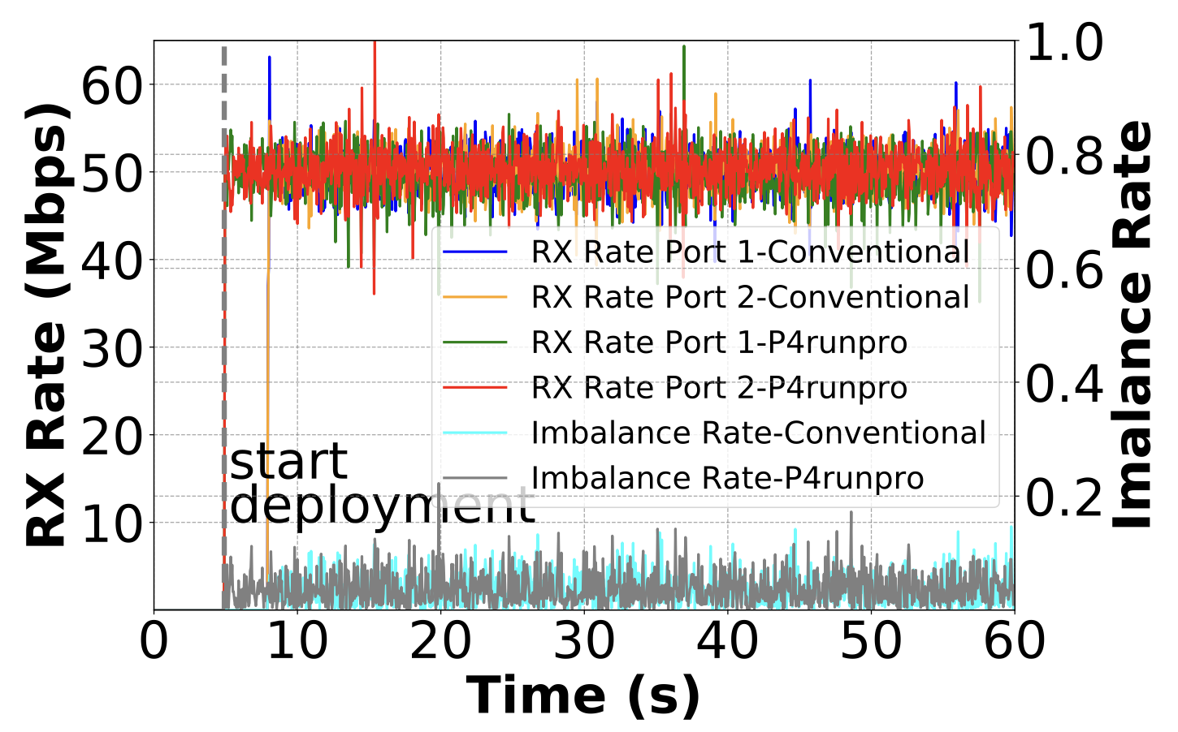
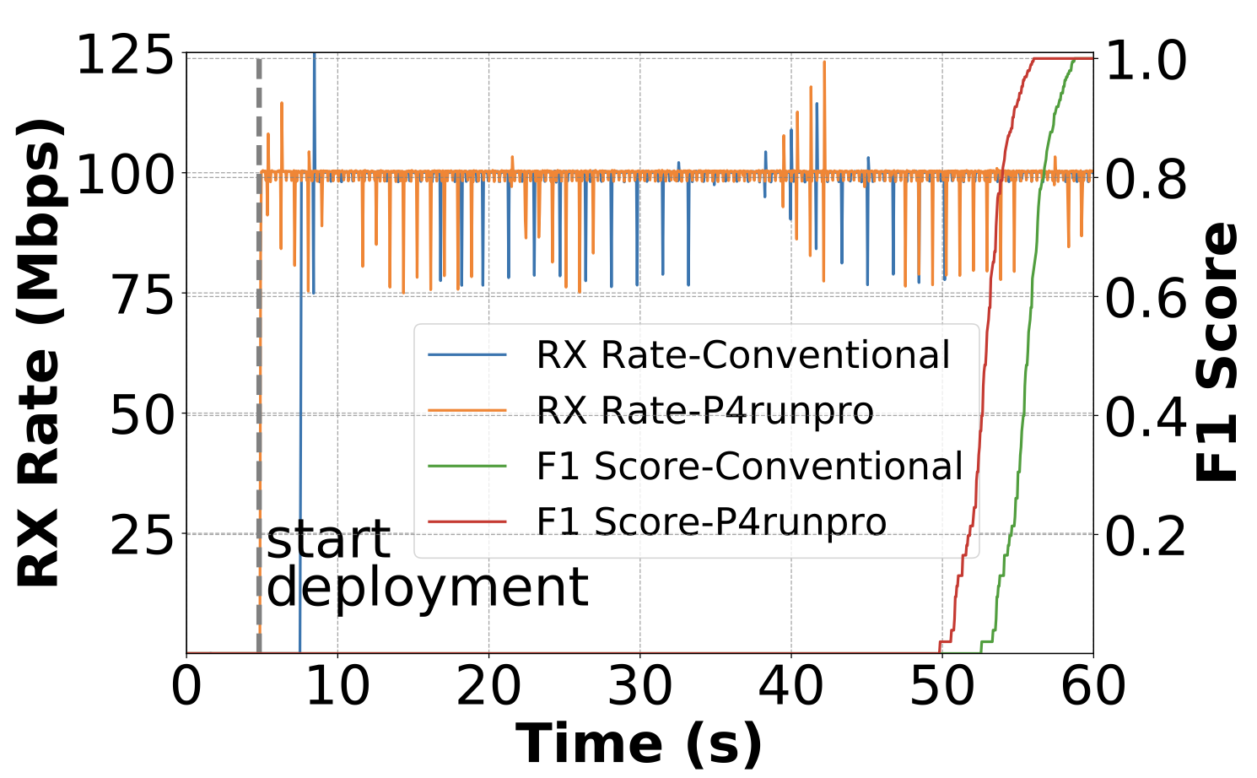
Case Studies
In-network cache
Stateless load balancer
Heavy hitter detector
Ground truth: cache read flow with the hit rate of 0.6
Evaluation index: imbalance rate
Evaluation index: F1 score
Nothing different but the reaction time!
Yifan Yang, Tsinghua University, SIGCOMM 2024
Notes:
At last, we conducted several case studies to prove that the P4runpro programs have the same functionality as the corresponding P4 programs.
We start deploying the P4runpro programs and the P4 programs at the same time.
Our results show that there is nothing different in functionality, but the P4runpro programs have faster reaction times since they can be updated at runtime.

Slide 33
Conclusion
P4runpro achieves runtime programmability for RMT switches
Provides a one-shot compiled data plane to virtualize the hardware
Provides an expressive primitive set for general-purpose switch programming
Supports automatic runtime program deployment in a few hundred milliseconds
Our paper: https://doi.org/10.1145/3651890.3672230
Our prototype: https://github.com/P4runpro/P4runpro
This presentation is supported by the Deng Feng Fund of Tsinghua University
Thanks!
Contact: yangyifan0202@gmail.com
Yifan Yang, Tsinghua University, SIGCOMM 2024
Notes:
So, we conclude that P4runpro achieves runtime programmability for RMT switches.
It provides a one-shot-compilation data plane to virtualize the hardware.
It provides an expressive primitive set for general-purpose switch programming
It supports automatic runtime program deployment in a few hundred milliseconds
Our code is open-sourced at GitHub.
This presentation is supported by the Deng Feng Fund of Tsinghua University.
That’s all, thanks for your attention.

